Slide 1
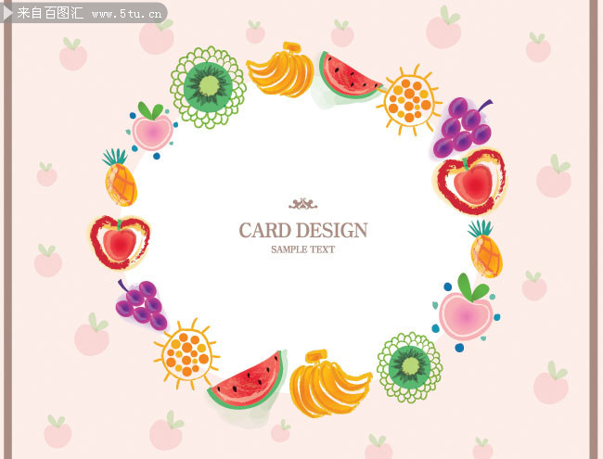
Unit 5 Do you like pears?
Let’s learn.

Slide 2
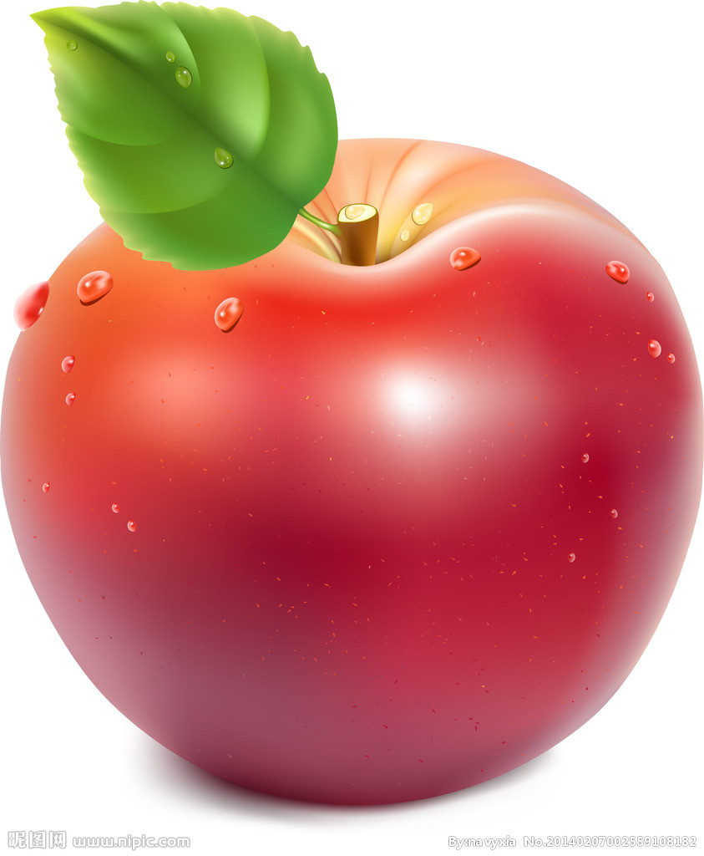
Chant with me!
Amy likes apples,
Apples, apples, apples,
A says a a
Apples, apples apples

Slide 3
I like apples.
It’s red and round.
It’s sweet.

Slide 4
What’s your favourite fruit?

Slide 5
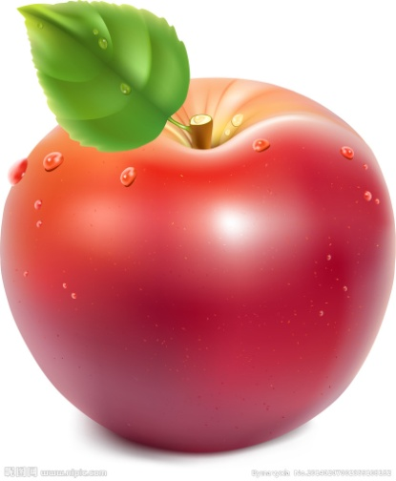
Peppa likes apples.

Slide 6
Peppa buys some fruits with her family.

Slide 7
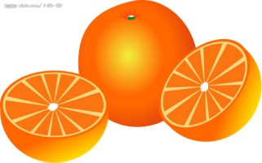
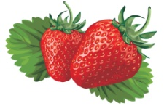
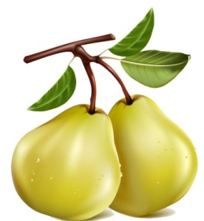
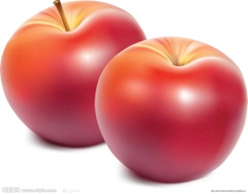
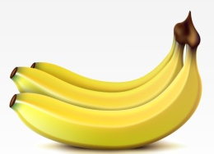

Slide 8
What fruit do they buy?

Slide 9
A: Do you like pears? B: Yes, I do./ No, I don’t.

Slide 10
Make a survey
Me

Slide 11
We like juice at party.

Slide 12
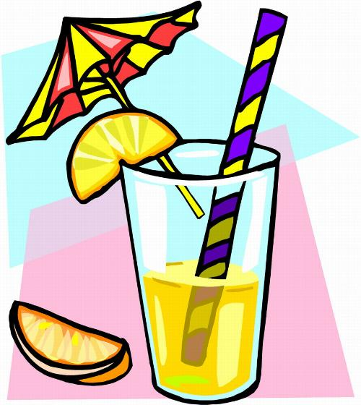
Fill in the blank.
E.g. Peppa likes _apples_.
Rebecca Rabbit likes _______.
Edward Elephant likes _______.
Suzy Sheep likes ____.
George likes ______.
They like ______ juice. It’s ________ .

Slide 13
Example:Let’s make juice!
Choose one or two fruits, draw and write.
We like _pears_.
We make _pear_ juice with _eight_ _ pears _.

Slide 14
Group work :Let’s make juice!
Choose one or two fruits, draw and write.
We like __________.
We make ______ juice with _______ ______.

Slide 15
An apple a day keeps the doctor away!

Slide 16
Enjoy the song!

